Slide 1
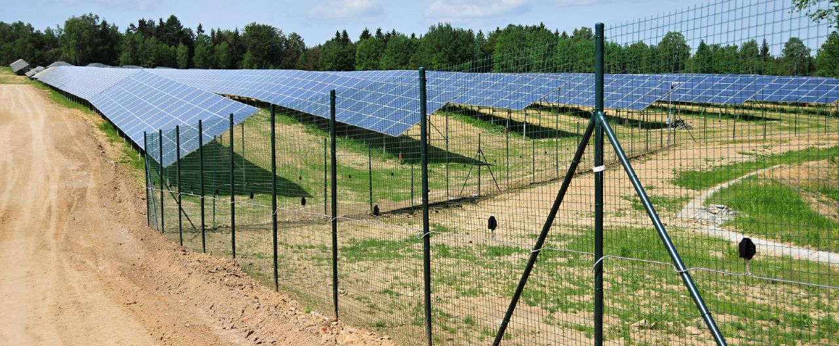
Professional perimeter intrusion detection system
Powered by

Slide 2
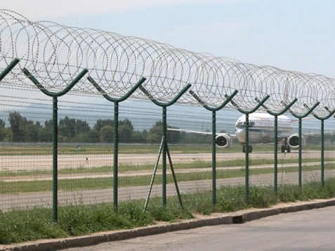
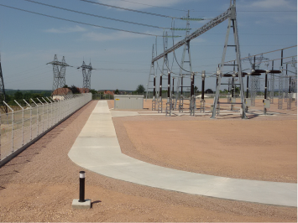
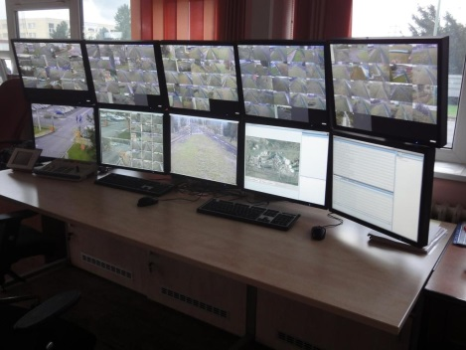
BẢO VỆ KHU VỰC QUAN TRỌNG HIỆU QUẢ
PROTECTS YOUR PERIMETER MORE EFFECTIVELY
+ Detects an intruder directly on the boundary of the protected area
+ Suitable for various types of fences.
+ Gains sufficient time for the security operator for an effective reaction
+ For medium-sized and large installations.
Professional perimeter intrusion detection system

Slide 3
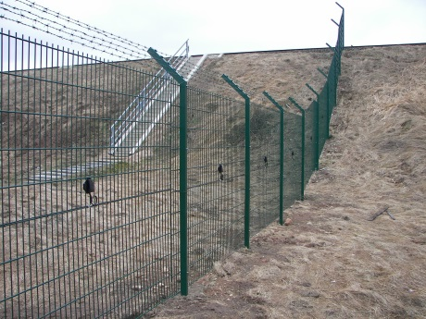
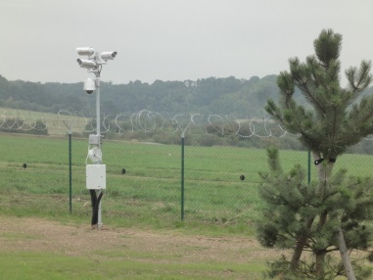
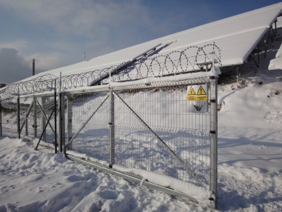
PERIDECT+ FEATURES AND BENEFITS
+ Extremely low false alarm rate
Unique algorithm comparing data from neighbouring detectors dramatically reduces false alarms (wind...)
+ Cost effective solution
One control unit CUP+ (with two line controllers LCP+) cover up to 3 km of your perimeter
+ Native integration with IP cameras
IP PTZ camera can be automatically directed to move to the intrusion area for two-step verification
+ Detection accuracy
Addressable vibration sensors fitted at each fence panel support very high detection accuracy
+ Antivandal solution
Stainless steel tube for cables increases protection against mechanical damage and EM interference
Professional perimeter intrusion detection system

Slide 4
PERIDECT+ FEATURES AND BENEFITS
+ Galvanic isolation of detection line
Each detection line is galvanically isolated from the LCP+ unit to provide much higher EM immunity
+ Redundancy
Ring connection with one control unit and two line controllers (master/slave) can be used for system back up in case of detection line interruption or a short circuit
+ Modularity
Modular architecture allows easy modification and system extension in the future
+ Integration with 3rd party systems
Programmable outputs and an open API are available for 3rd party system integration
+ Symmetrical connection of detectors
A two-wire connection simplifies installation and increases system resistance to EM interference
Professional perimeter intrusion detection system

Slide 5
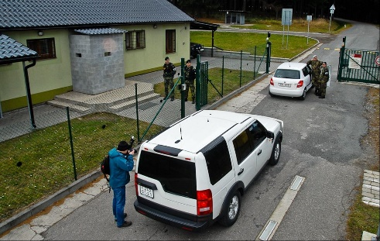
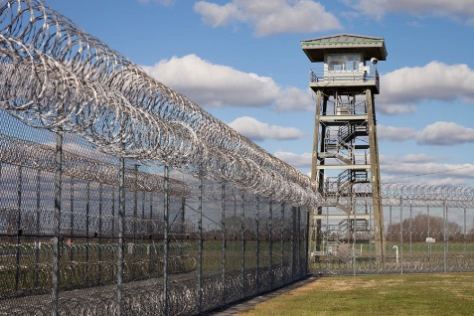
INDUSTRIES AND APPLICATIONS
Industrial and commercial sites
Strategic and critical infrastructure
+ Power plants
+ Airports
+ Prisons
+ Military areas
+ Embassies
+ National borders
Professional perimeter intrusion detection system

Slide 6
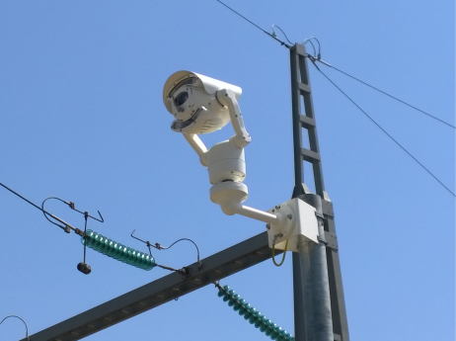
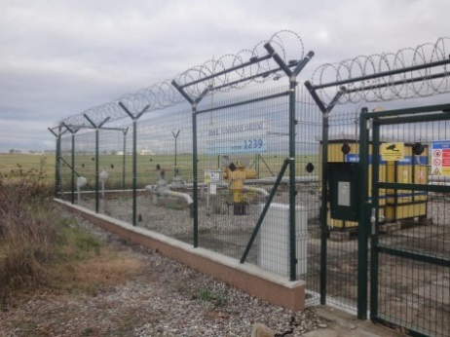
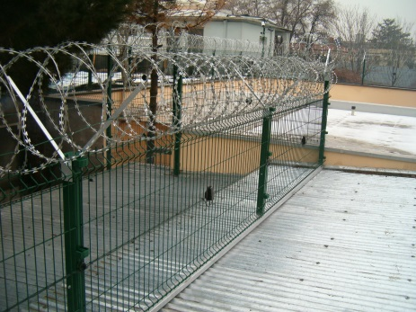
TECHNICAL FEATURES
+ Up to 500 addresses per one Line Controller – up to 1.5 km of perimeter
+ Safeguarded detection line – master and slave redundant system
+ Separators securing the operation of the line in case of short-circuit
+ Individual set up of each detector (sensor)
+ Higher communication speed – increased quantity of evaluated data
+ LAN, RS485 connections directly build in the CUP+ control unit
+ No moving parts – higher reliability
+ Analogue cameras support
Professional perimeter intrusion detection system

Slide 7
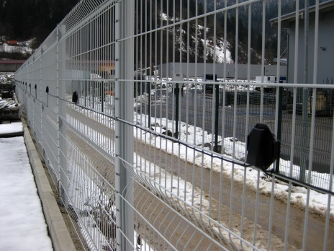
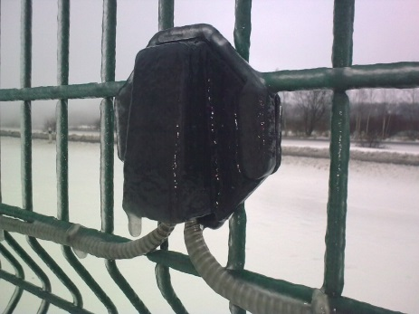
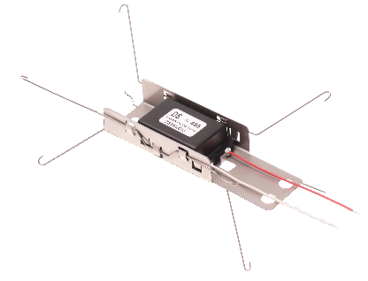
PERIDECT+ VERSIONS
+ PERIDECT+ Standard
> Basic version
> Supplied with detectors connected from manufacturer production
> UV resistant two-wire cable for outdoor use
+ PERIDECT+ Antivandal
> Cable protected by stainless steel tube
> Increased resistance version
> Protection against mechanical damage and electromagnetic interference
+ PERIDECT+ Hidden
> Invisible detection system
> Detectors installed Inside posts
> Supplied disassembled
Professional perimeter intrusion detection system

Slide 8
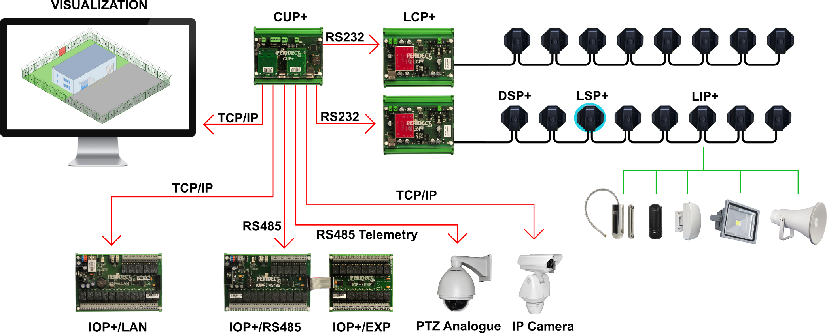
Typical architecture of PERIDECT+
Professional perimeter intrusion detection system

Slide 9
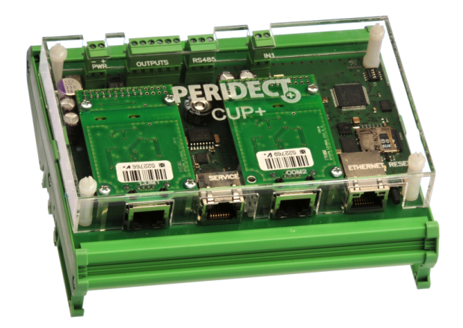
CONTROL UNIT PERIDECT+
Control Unit PERIDECT+ (CUP+)
> Modular Industrial Computer
> LAN - TCP/IP for connection to Internet
> 4x directly controlled logical outputs
> 2x inputs for line modules (LCP+, PVJ, etc.)
> RS485 communication bus integrated
Professional perimeter intrusion detection system

Slide 10
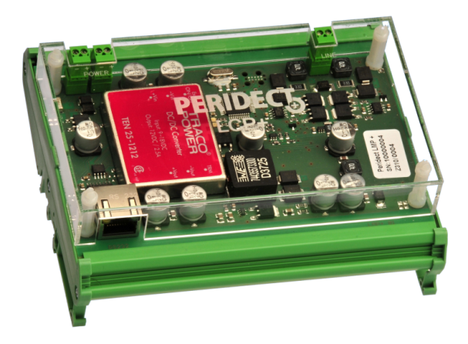
LINE CONTROLLER PERIDECT+
Line Controller PERIDECT+ (LCP+)
> Line module for communication with
detection line
> Galvanic isolation of detection line
> Up to 500 detectors DSP+ or other
modules
> Immune symetric communication
Professional perimeter intrusion detection system

Slide 11
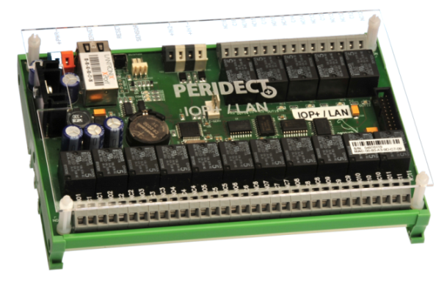
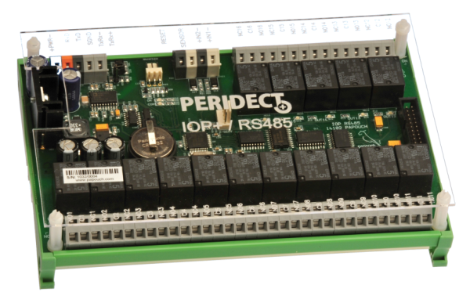
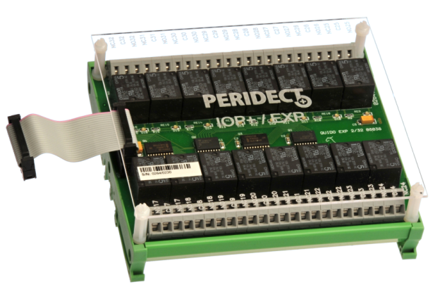
I/O MODULES
I/O LAN Module PERIDECT+ (IOP+/LAN)
I/O RS485 Module PERIDECT+ (IOP+/RS485)
I/O Expansion Module PERIDECT+ (IOP+/EXP)
> 16 relay outputs
> Switching contacts
> 2 double balanced inputs
> 16 relay outputs
> Switching contact
> 2 double balanced inputs
> Expansion module for IOP+/LAN and
IOP+/RS485
> Switching contacts
> Additional 16 relay outputs
Professional perimeter intrusion detection system

Slide 12
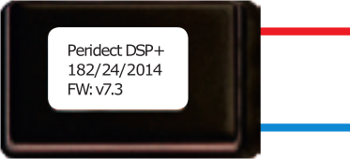
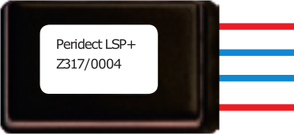
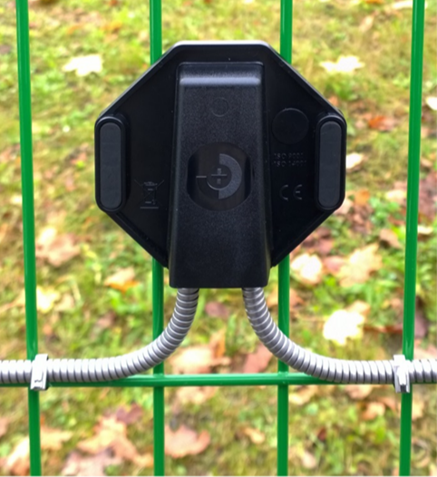
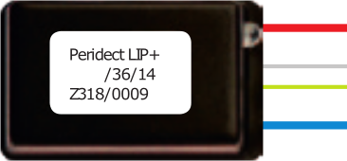
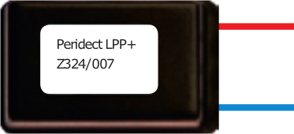
DETECTION LINE
Detection Sensor PERIDECT+ (DSP+)
Line Separator PERIDECT+ (LSP+)
Plastic cover for all detection line components
> Increased sensitivity
> Remote setting of sensitivity
> Software sensitivity set up
> Limits short-circuit on the detection line
> Maximum 20 separators per one line
> Built-in overvoltage protection
Line Input PERIDECT+ (LIP+)
Line Protector PERIDECT+ (LPP+)
> 2 double balanced inputs + 1 output
> Fitting on any place on the line
> Max. 64 per one CUP+ (128 inputs)
> Overvoltage electronic protector
> UV resistant polycarbonate cover
> Protection against unathorized manipulation
Professional perimeter intrusion detection system

Slide 13
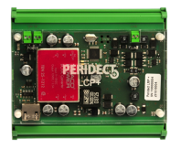
TYPICAL INSTALLATION EXAMPLE
CUP+
CUP+
Up to 3km (for 3m post spacing)
LCP+
LCP+
LCP+
LCP+
Up to 500 DSP+
Up to 500 DSP+
Up to 500 DSP+
Up to 500 DSP+
Unlimited total length of perimeter
Professional perimeter intrusion detection system

Slide 14
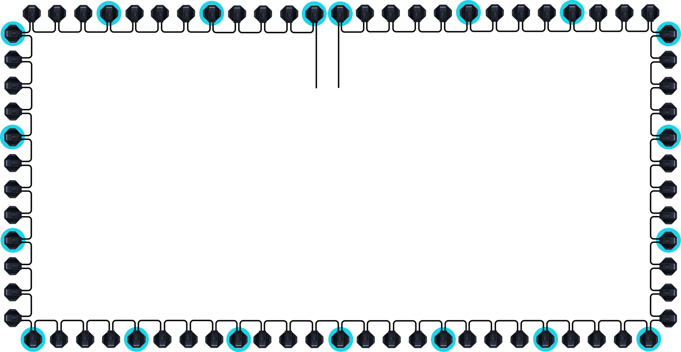
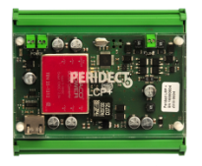
BASIC REDUNDANCY EXAMPLE
LCP+ MASTER
LCP+ SLAVE
CUP+
Up to 500 DSP+
Up to 1,5 km
- Separator
Professional perimeter intrusion detection system

Slide 15
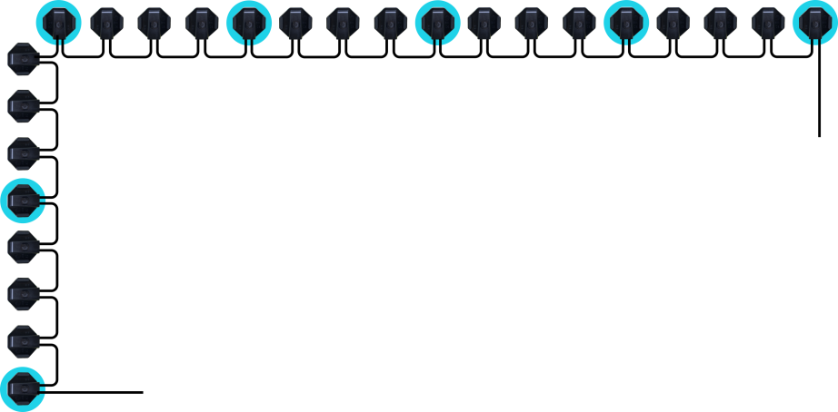
ADVANCED REDUNDANCY EXAMPLE – LONG PERIMETER
Up to 1,5 km (for 3 m post spacing)
LCP+
LCP+
LCP+
LCP+
CUP+
CUP+
Unlimited total length of perimeter
CUP+
CUP+
LCP+
LCP+
LCP+
LCP+
- Separator
Professional perimeter intrusion detection system

Slide 16
Eliminate number of false alarms and protect your perimeter even more effectively!
Eurostellar |0902 401 488 |info@eurostellar.com |www.eurostellar.com

